Slide 1
English I
UNIT I
Riham A. Al-anssari

Slide 2
Content List
Reading surveying
Key language the alphabet
Writing
Vocabulary development

Slide 3
Reading
STUDY SKILL Surveying
Before you read a text, look at the page quickly. Ask:
■ What is the title?
■ What do the pictures show?
■ How many paragraphs are there?
The answers help you understand what a text is about.

Slide 4
Reading
■ What is the title?
■ What do the pictures show?
■ How many paragraphs are there?

Slide 5
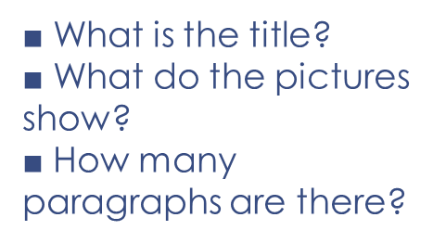
Reading

Slide 6
Reading

Slide 7
Reading

Slide 8
Reading

Slide 9
Reading

Slide 10
Reading

Slide 11
Reading

Slide 12
Key language

Slide 13
Key language
Knowing the alphabet helps you:
■ find words in a dictionary
■ record vocabulary in a notebook or computer file

Slide 14
Key language
Write the words in alphabetical order:
Lecturer
Student
Teacher
Doctor
dentist
engineer

Slide 15
Key language
Write the words in alphabetical order.
Lecturer
Student
Teacher
Doctor
Dentist
Engineer

Slide 16
Key language
Write the words in alphabetical order.
Lecturer
Student
Teacher
Doctor
Dentist
Engineer

Slide 17
Key language
Write the words in alphabetical order.
Lecturer
Student
Teacher
Doctor
Dentist
Engineer

Slide 18
Key language
Write the words in alphabetical order.
Lecturer
Student
Teacher
Doctor
Dentist
Engineer

Slide 19
Key language
Write the words in alphabetical order.
Lecturer
Student
Teacher
Doctor
Dentist
Engineer

Slide 20
Key language
Write the words in alphabetical order.
Lecturer
Student
Teacher
Doctor
Dentist
Engineer
Dentist
Doctor
Engineer
Lecturer
Student
Teacher

Slide 21
Key language
26 alphabet letters
21 consonant ( b, c, r,…) 5 vowels (a, e, i , o, u)

Slide 22
Writing
RULES Articles a and an
Use a before a word beginning with a consonant;
a doctor a student
Use an before a word beginning with a vowel sound:
an engineer an accountant

Slide 23
Writing
STUDY SKILL Punctuation (1)
Use CAPITAL LETTERS for:
the start of sentences: He is a doctor.
names of people and places: Jane, Brazil.
the pronoun I: Jane and I come from Australia.
End sentences with a full stop (.).

Slide 24
Writing
STUDY SKILL Checking your writing
It is important to check your writing for mistakes. Check:
the subject and the verb:
He go to university. He goes to university.

Slide 25
Writing
STUDY SKILL Checking your writing
It is important to check your writing for mistakes. Check:
the subject and the verb:
He go to university. He goes to university.
articles;
She is a engineer . She is an engineer.

Slide 26
Writing

Slide 27
VOCABULARY DEVELOPMENT

Slide 28
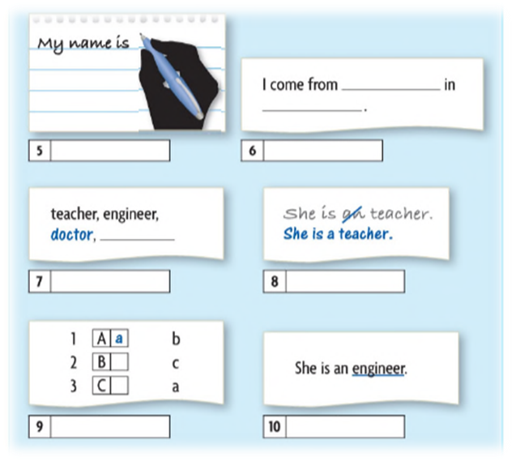
VOCABULARY DEVELOPMENT

Slide 29
VOCABULARY DEVELOPMENT
write
complete
Number
add
correct
label
circle
match
underline

Slide 30
VOCABULARY DEVELOPMENT
Underline the verb.
She works at a school.
circle the country.
He comes from New Zealand

Slide 31
VOCABULARY DEVELOPMENT
Underline the verb.
She works at a school.
circle the country.
He comes from New Zealand

Slide 32
VOCABULARY DEVELOPMENT
Underline the verb.
She works at a school.
circle the country.
He comes from New Zealand

